Slide 1
DATA SCIENCE
10 WEEK PART TIME COURSE
Week 2 - Data Visualisation

Slide 2
AGENDA
What is Data Visualisation?
Why do we visualise data?
How do we visualise data?
Lab
Discussion

Slide 3
WHAT IS DATA VISUALISATION?
DATA SCIENCE PART TIME COURSE

Slide 4
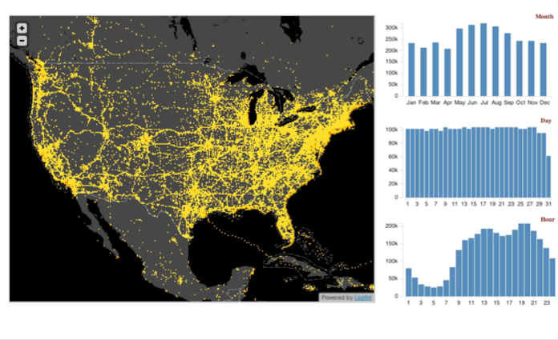
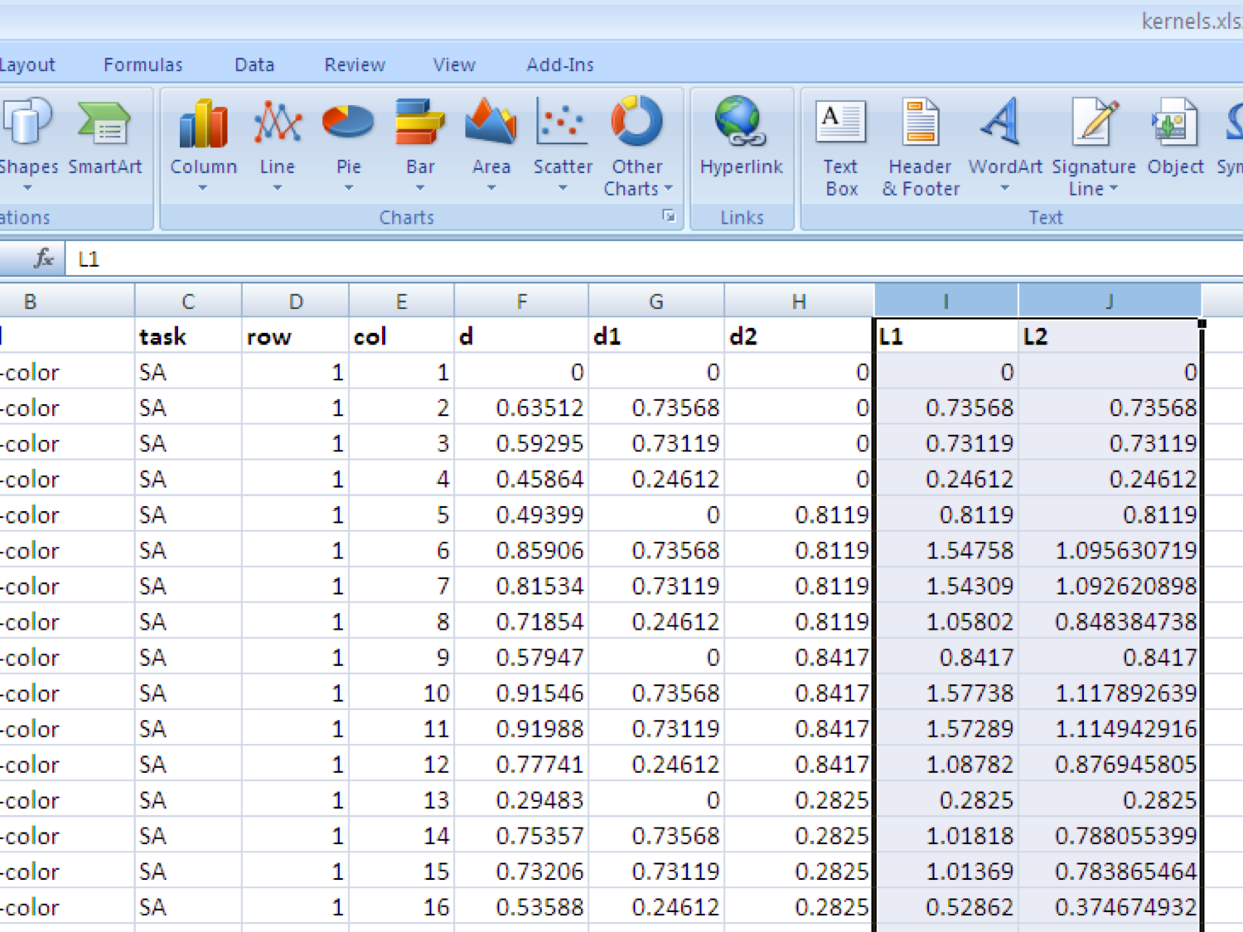
WHAT IS DATA VISUALISATION?
Present information that is intuitive and clear for the viewer
Turn numbers in a spreadsheet into something people can interpret and extract insights

Slide 5
Act
Decide
Remember
Understand
Notice
Ad-run

Slide 6
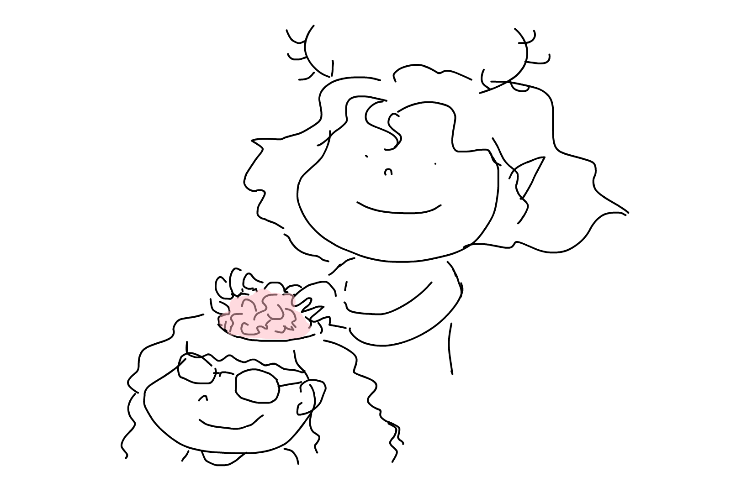
GOOD VISUALS HELP PEOPLE NOTICE AND REMEMBER
Ignore Greg, he’s hopeless at this
Work out which attribute(s) you want to highlight
Inject them into your audience’s perception non-cognitively
What do want to show as “background”?
Make it bland and require thought to process

Slide 7
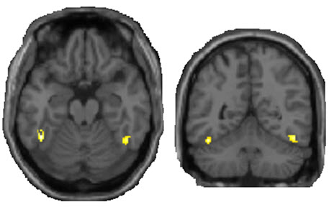
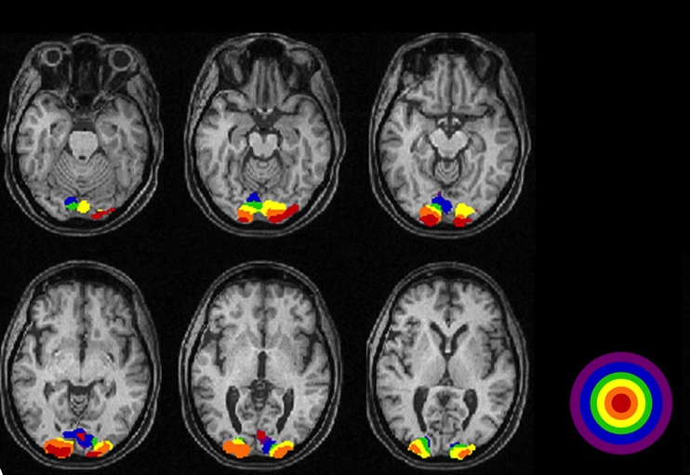
Hacking the human perception system
You detect these things using very little effort:
Faces and facial expressions
Movement and changes in size or shape
Objects which are different colour to their surroundings
Space and location

Slide 8
Example
The next slide will be shown for only a few moments
Ready? 3…2…1…

Slide 9

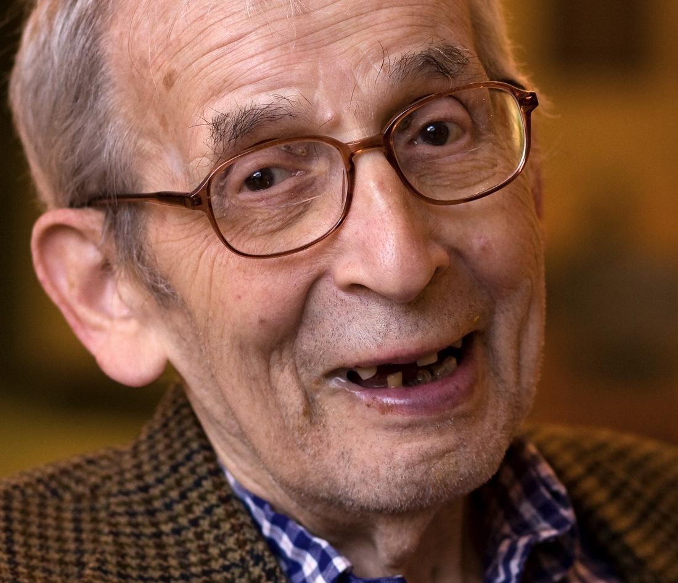


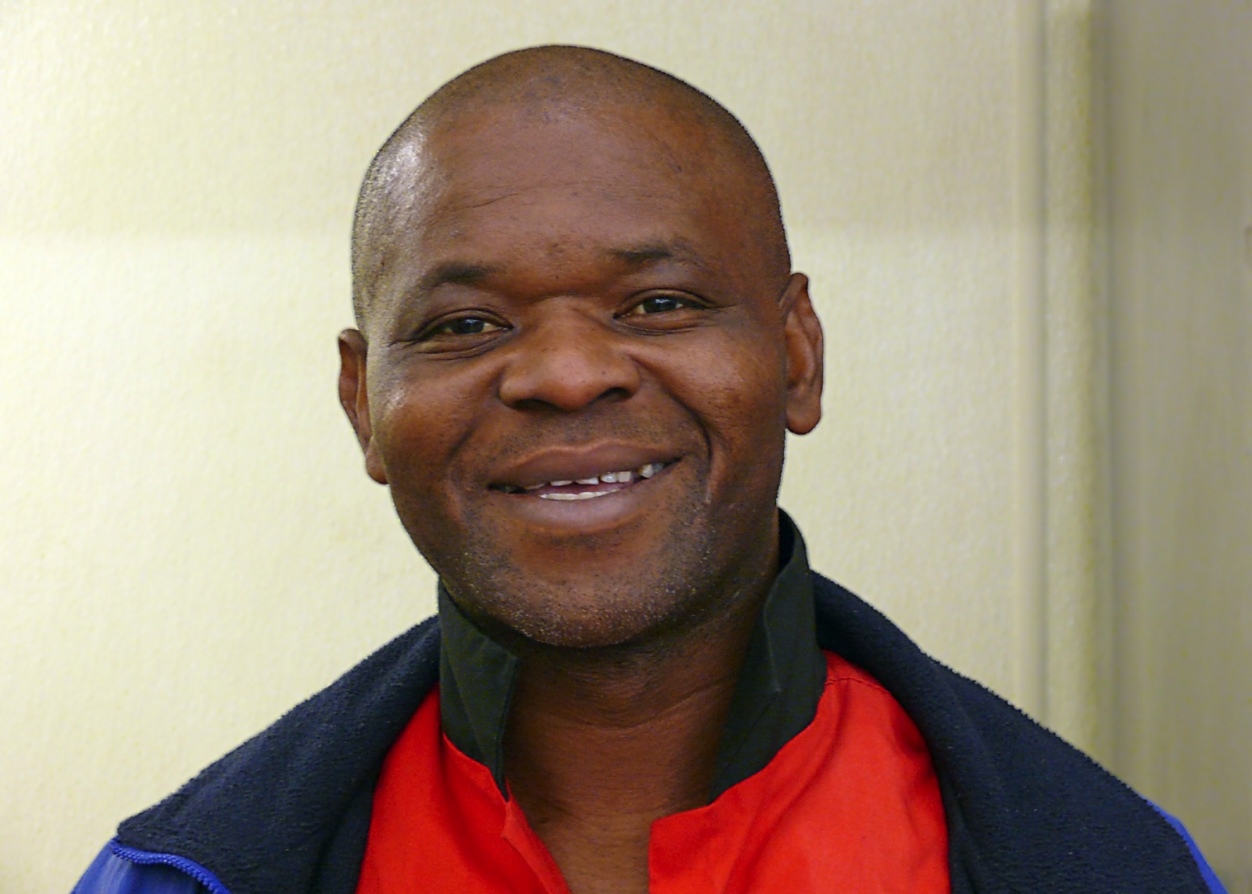
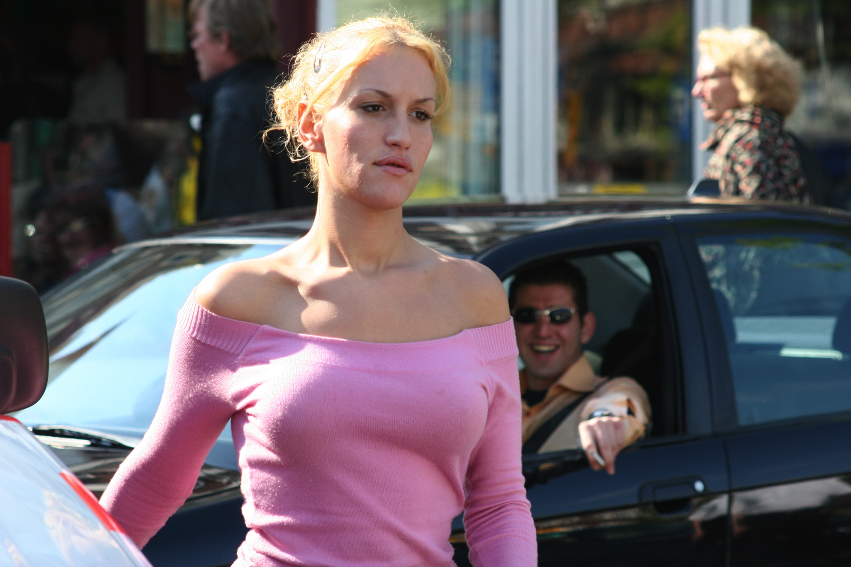

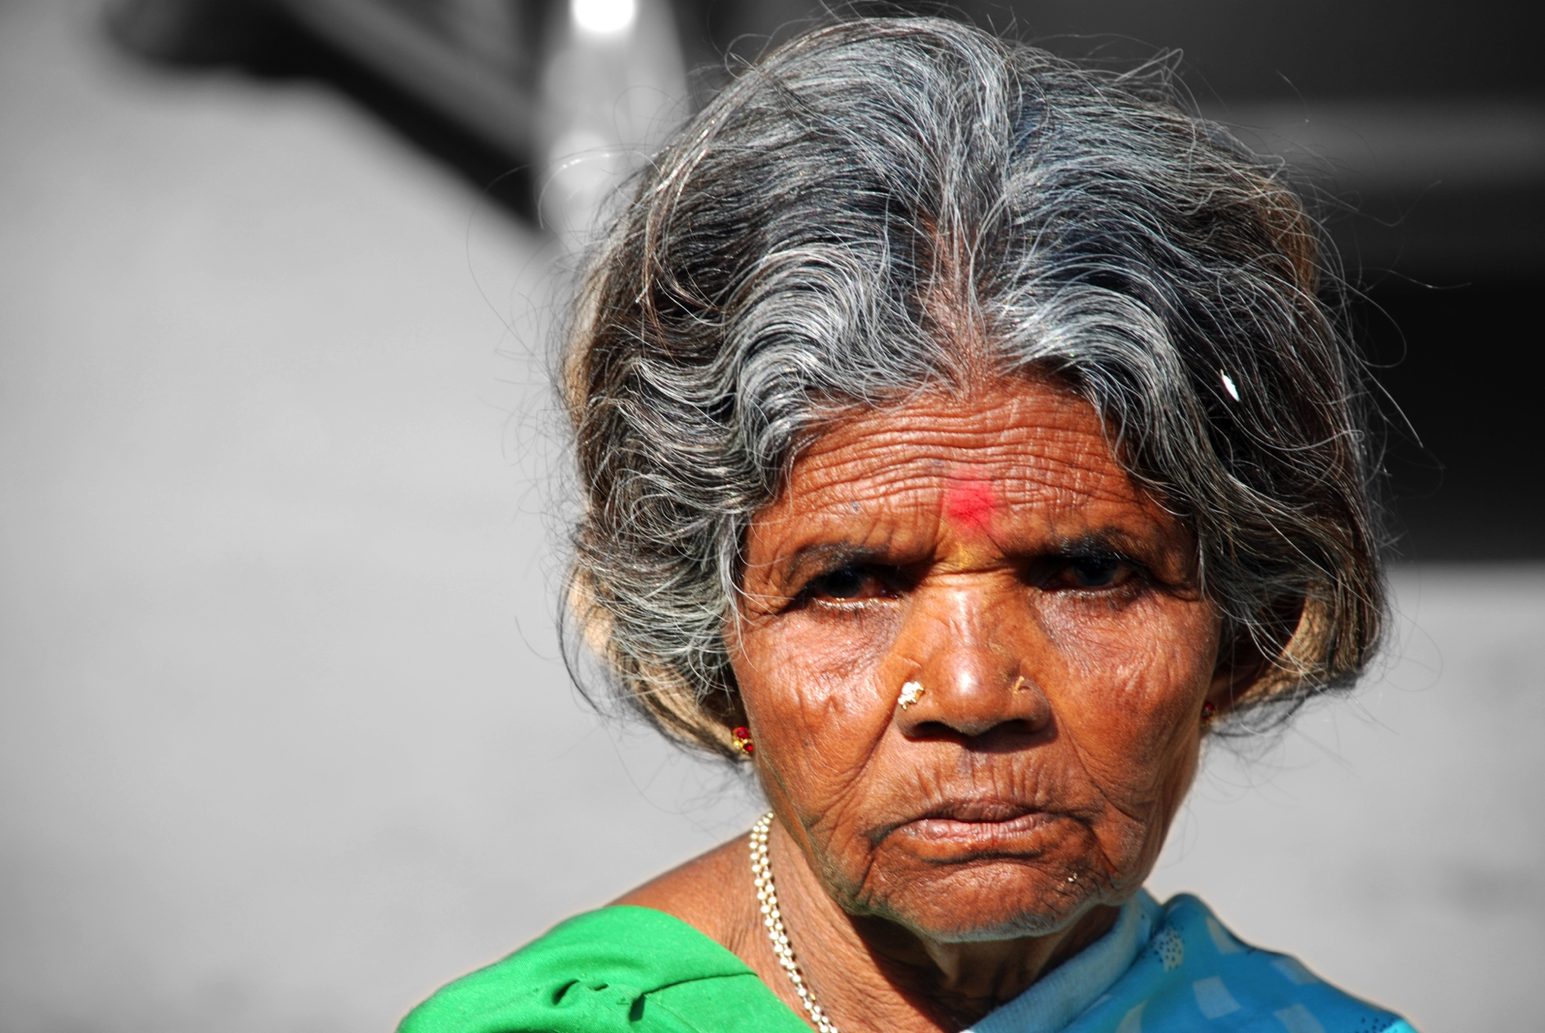

Slide 10
REFLECTION
How many faces did you see?
Describe them (gender / race / age)
Where they happy or sad?
Bonus: what were you thinking when you saw the faces?
https://www.reddit.com/r/Pareidolia/
https://en.wikipedia.org/wiki/Chernoff_face

Slide 11
Movement and shape changes
The next slide will be shown for only a few moments
Ready? 3… 2… 1…
Ready? 3…2…1…

Slide 12
Which one just changed colour?
Which one just moved?

Slide 13
COLOUR
Black dots against a white background
Highlight a set of points with a different colour
Try to make the diagram work in black and white first, then add colour
Red / green:
8% of Caucasian males
Reds are darker
Try darkred / lime

Slide 14
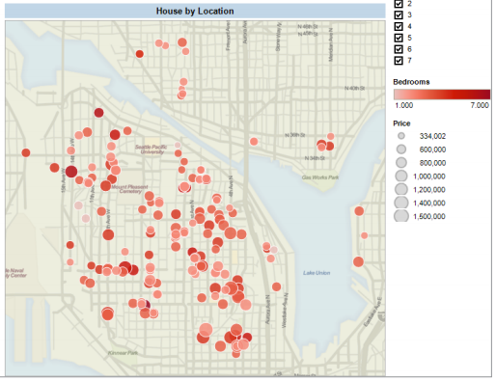
MAP OVERLAYS WORK OUR SPATIAL SENSE

Slide 15




COMMON TOOLS FOR VISUALISATION
Power
Ease of Use

Slide 16

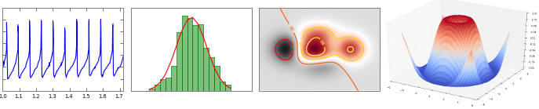
WHY MAPLOTLIB?
Python graphics plotting library
Plots numpy arrays
Pandas DataFrames and Series behave like numpy arrays

Slide 17
Pandas built-ins (Easy stuff)
DATA SCIENCE PART TIME COURSE

Slide 18
Using matplotlib (the easy way)
%matplotlib inline
Put this at the start of your jupyter notebook
Try pandas DataFrame / Series calls
Pass-through API: df.plot() , df.plot.scatter(), s.plot.bar()
Roughly equivalent to Excel charts

Slide 19
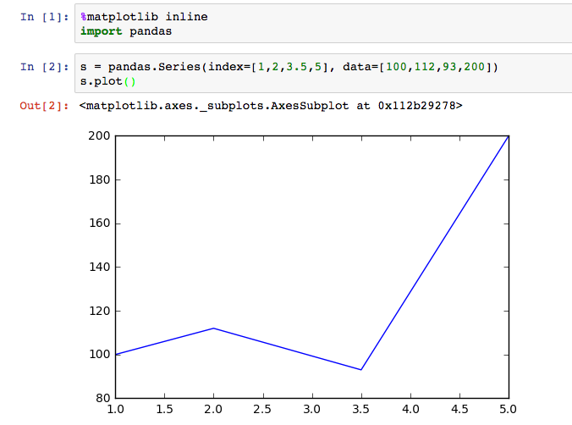
Line plot
Plots a Series

Slide 20
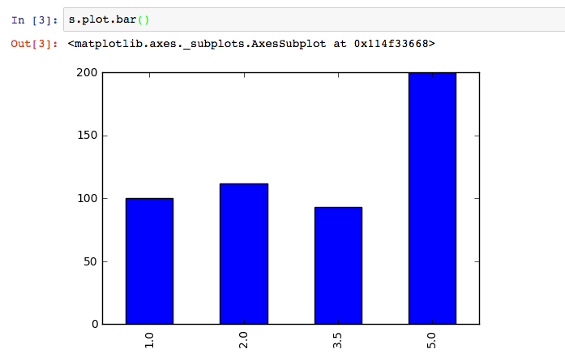
Bar charts
The index doesn’t have to be a list of numbers

Slide 21
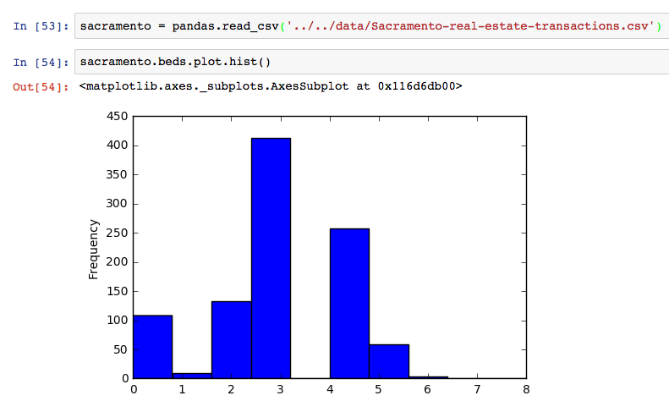
Histogram

Slide 22
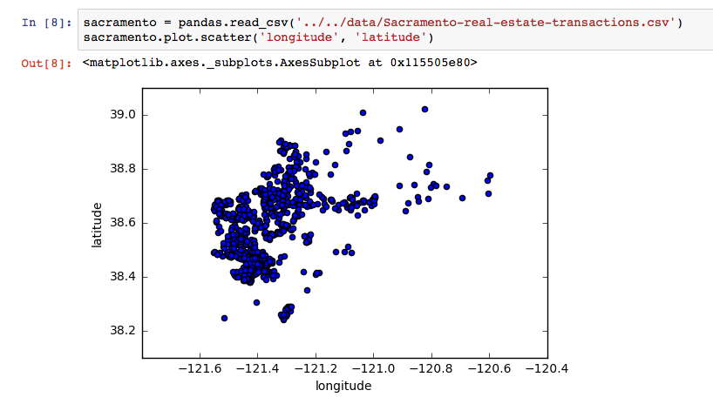
Scatter plots (and very primitive geographical plots)
Dataframe column names
Also try:
Google Fusion Tables
Tableau
mpl_tools.Basemap

Slide 23
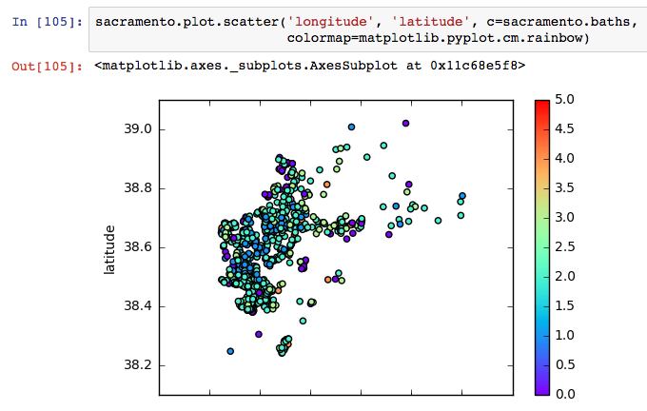
Scatter with colour – specify a colourmap

Slide 24
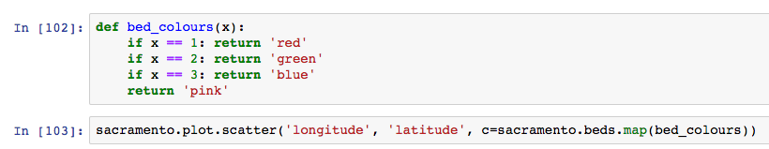
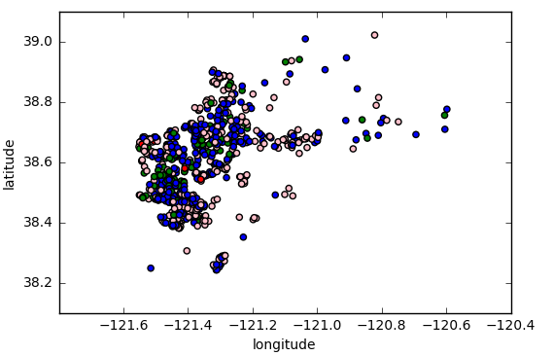
Scatter with colour – specify the colours

Slide 25
Useful tricks
How to get an array of colours
import numpy
c = numpy.where(df.Gender == 'female', 'pink', 'blue')
df.plot.scatter(df.Age, df.Income, c=c)
Big blobs
df.plot.scatter(df.Age,df.Mortality, s=df.Income/1000)

Slide 26
Matplotlib
DATA SCIENCE PART TIME COURSE

Slide 27
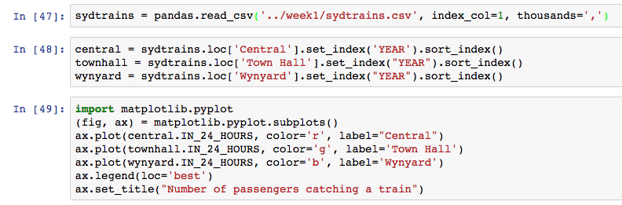
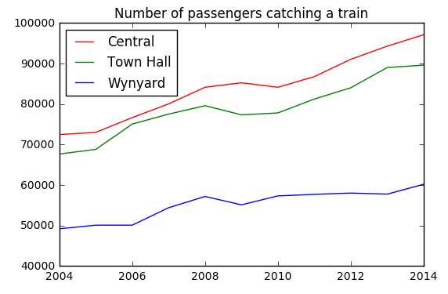
Several plots on the same graph

Slide 28
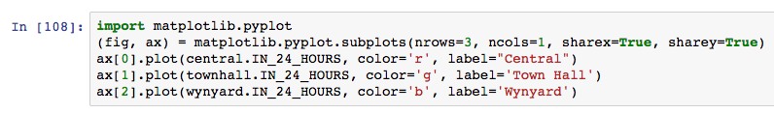
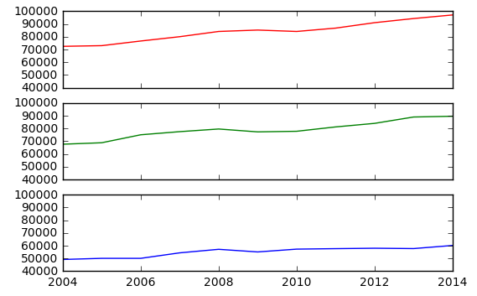
Several plots sharing axes but on different graphs

Slide 29
Animation
http://matplotlib.org/2.0.0/api/animation_api.html
Only if you are feeling confident in your coding skills
ax.plot() returns a line
Create a function that calls line.set_data(…)
Construct animation.FuncAnimation from the function

Slide 30
Seaborn (Pretty graphs made easy)
DATA SCIENCE PART TIME COURSE

Slide 31
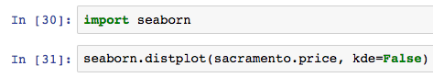
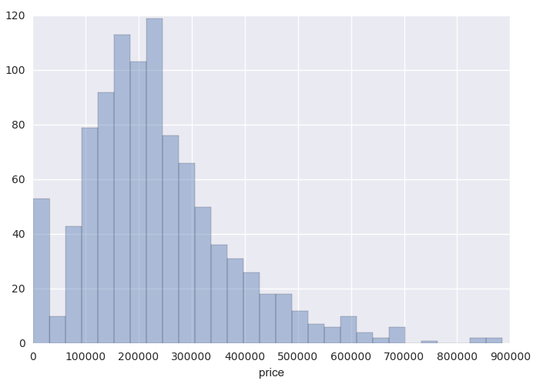
Distribution of a single variable

Slide 32
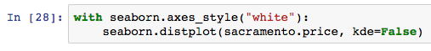
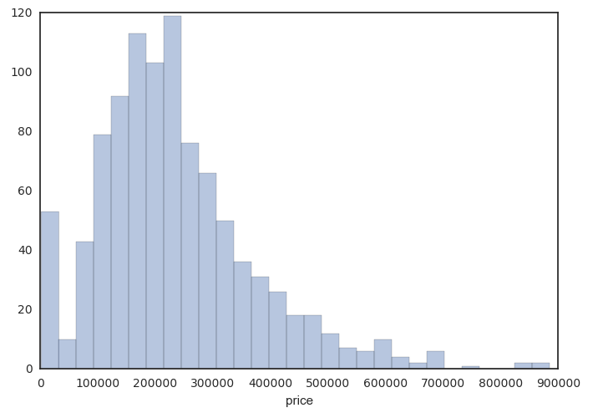
Changing the style

Slide 33
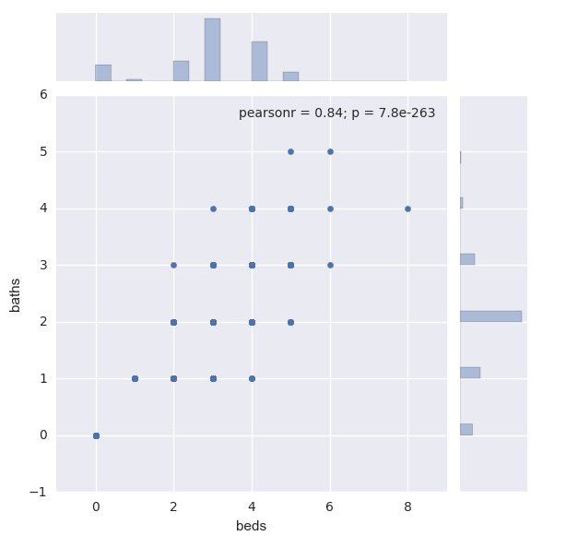
Bivariate data

Slide 34
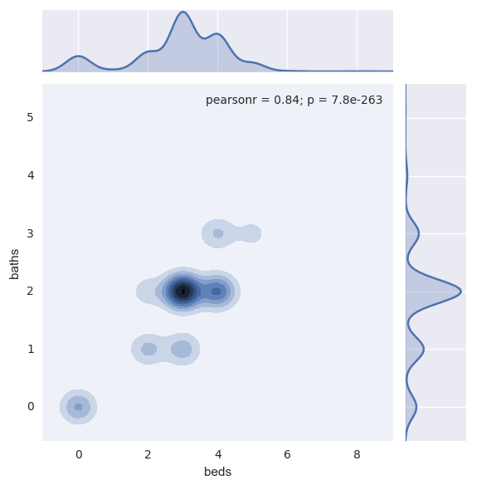
Kernel Density estimate

Slide 35
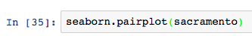
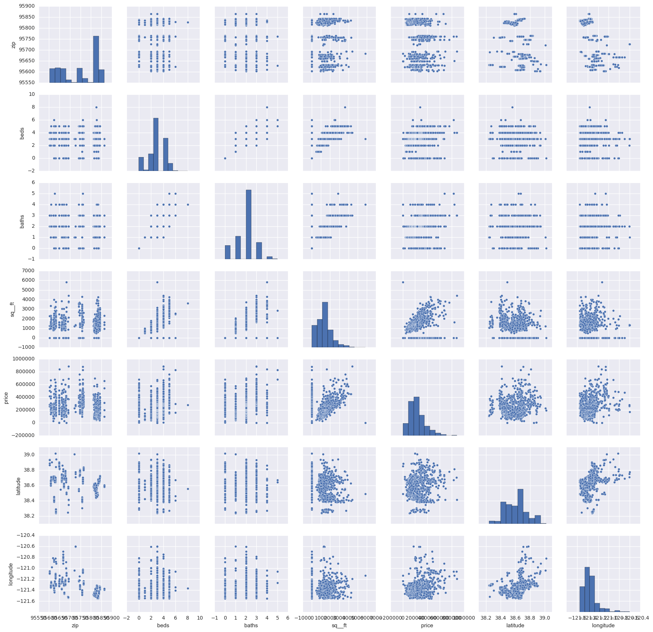
Pairplot

Slide 36
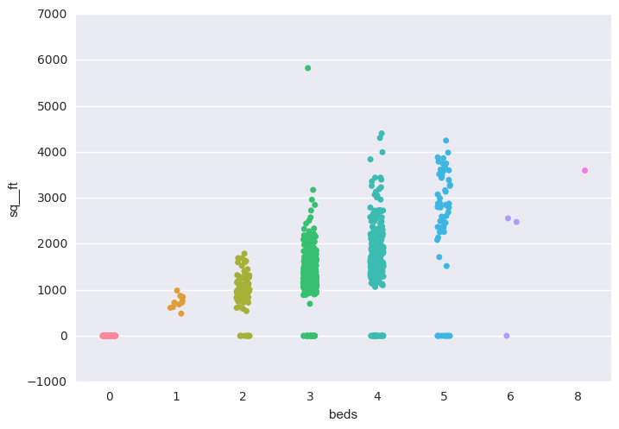
Displaying categorical data - stripplot

Slide 37
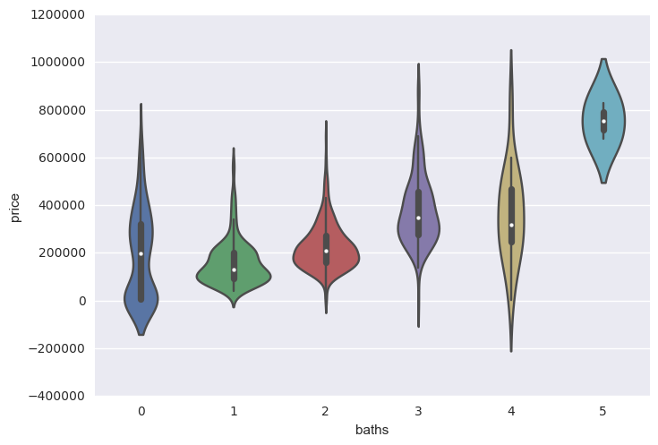
Displaying categorical data - violinplot

Slide 38
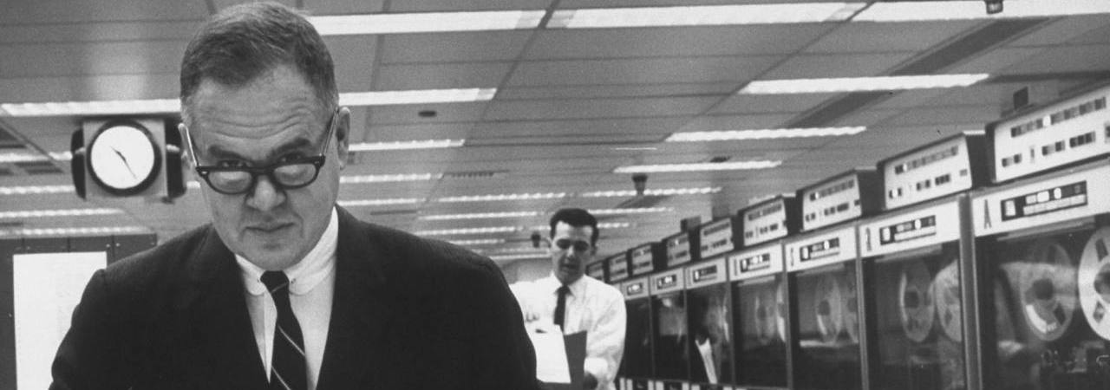

USING DATA SCIENCE PACKAGES
The greatest value of a picture is when it forces us to notice what we never expected to see.
John W. Tukey.
Exploratory Data Analysis. 1977.
DATA SCIENCE PART TIME COURSE

Slide 39
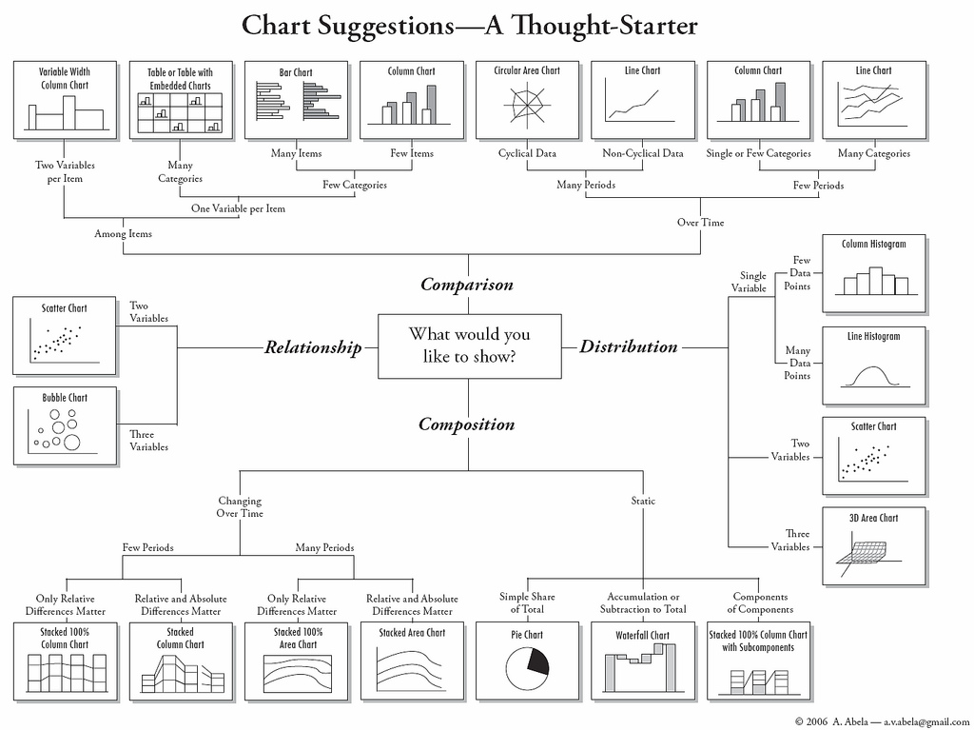

Slide 40
DATA VISUALISATION LAB
DATA SCIENCE PART TIME COURSE

Slide 41
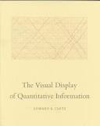
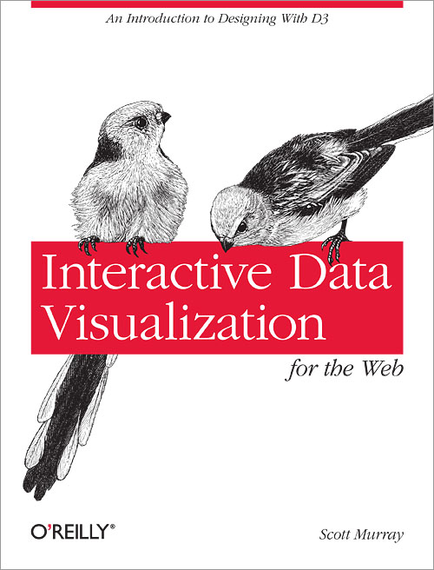
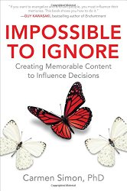
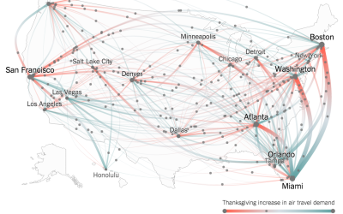
READINGS
All optional:
Edward Tufte, The Visual Display of Quantitative Information
Leland Wilkinson, The Grammar of Graphics
Scott Murray, Interactive Data Vis. for the Web (free online: flowingdata.com) Carmen Simon, Impossible to Ignore
DATA SCIENCE - Week 2 Day 1

Slide 42
DISCUSSION TIME
Homework/Course Project
How’s it going ?
DATA SCIENCE - Week 2 Day 1

